Slide 1


51st IG Meeting
South Gas Regional Initiative
12nd September 2019
Telco

Slide 2
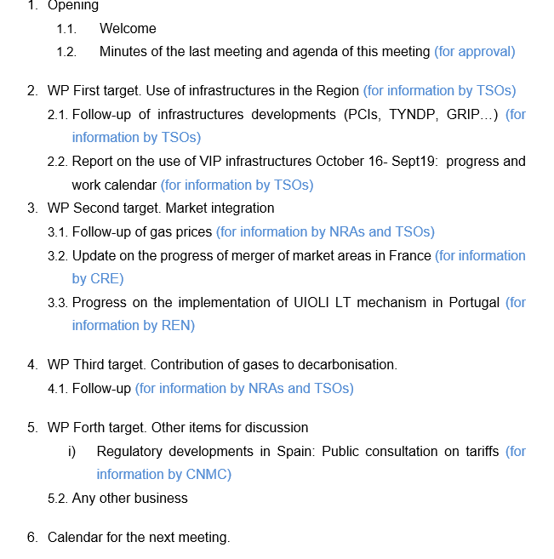
AGENDA

Slide 3
2. WP First target: use of infrastructures in the Region
2.1. Follow-up of infrastructure development (PCIs, TYNDP, GRIP…)
  For information by TSOs

Slide 4
2. WP First target: use of infrastructures in the Region
  2.2. Report on use of infrastructures (Oct16-Sept19): draft index (for information by TSOs)
  Assessment of the use of interconnections in the Region in the period 1st October 2016 to 30th April 2019.
  Draft index
  The current situation of gas interconnections in the Region (capacities, capacity calculation methodology).
  Assessment of capacity bookings.
  Assessment of the use of interconnections in the period October 2016 to September 2019
  Assessment of the gas flows and the congestion status.
    Analysis of the VIP’s congestion status.
    Use of anti-hoarding mechanisms in the region.
    Assessment of the CMP implementation.
  Conclusions and recommendations.

Slide 5
2. WP First target: use of infrastructures in the Region
  2.3. Report on use of infrastructures (Oct16-Sept19): state of play and next steps (for information by TSOs)
    Detailed index approved
    Period of analysis was extended: Oct16-Sept19
    The way forward agreed (two deliverables):
      December 2019 draft report for the period Oct16-June 19
      March 2020: final report (updated with Oct16-Sept19 data)
TSOs will periodically inform about the development of the report on the use of the interconnections in the period 1st October 2016 to 30th September 2019
Deadline: March 2020

Slide 6
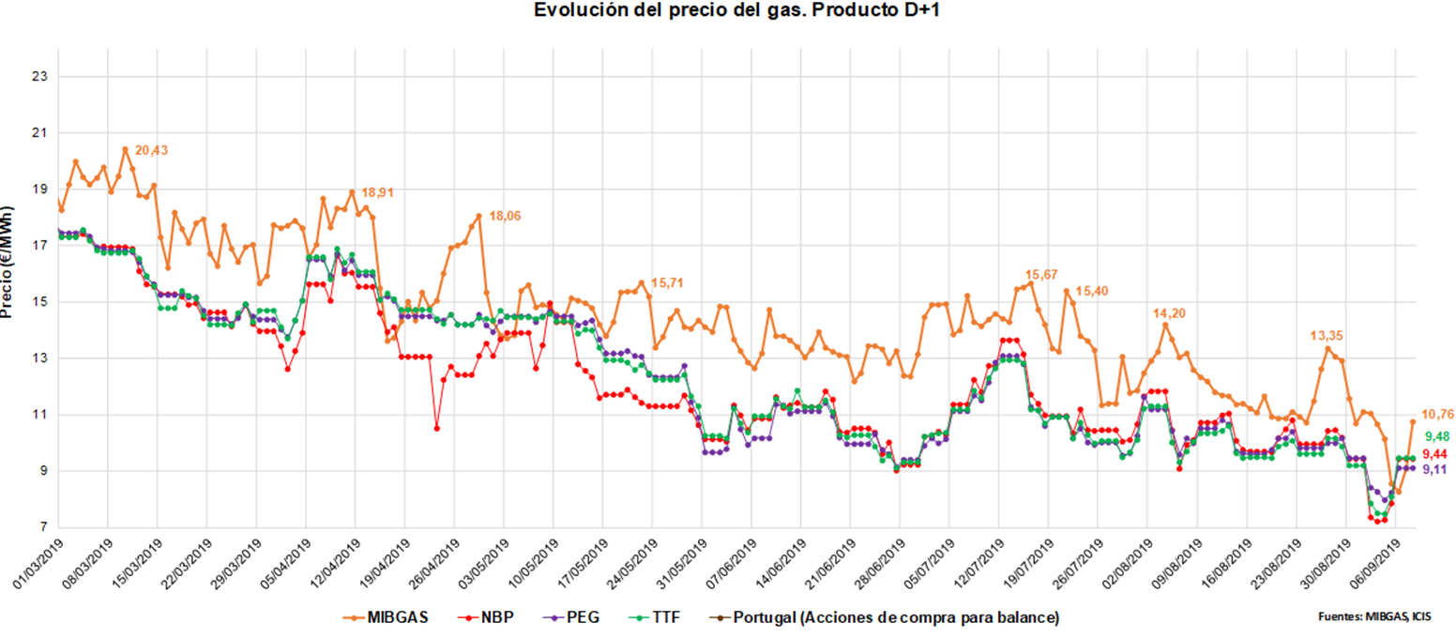
3. WP Second target: market integration
3.1. Follow-up of gas prices SGRI hubs vs. neighbouring hubs
(for information by NRAs and TSOs)
Evolution of prices D+1 (1st March 2019- 8th September 2019)

Slide 7
3. WP Second target: market integration
  3.2. Update on the progress of merger of market areas in France
  For information by CRE

Slide 8


Slide 9
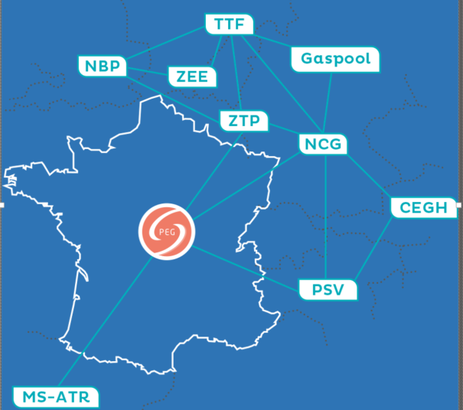
Single Trading region France (TRF) implementation
Since November 1st 2018, the 2 French gas market zones (PEG Nord and TRS) merged into a single marketplace – TRF (Trading region France) with a single exchange point – PEG.
The creation of the PEG has removed the spread between Northe and South (previsouly around €1,5-€2/MWh on average and as high as €20/MWh occasionally)
The PEG price felt from an average of €24,5/MWh in Nov. 2018 to €15,8/MWh in Mar. 2019, and to a very low of €c8/MWh early Sep. 2019, under the combined effect of mass arrival of LNG (+130% vs. previous winter), high level of gas in stock and the mildness of winter.
The PEG price reaches close-to-zero and even negative spreads with TTF.
As regard to liquidity of the PEG, the estimated bid-ask spread on day-ahead products felt fom €c13/MWh in winter 2017-18 to €c8/MWh in winter 2018-19.

Slide 10
Gas Flows
Acceleration of the return of LNG in the 3 French terminals : +130% compared to winter 2017-18 with a rate of use of terminals of c50%.
Very low entry flows at Obergailbach (-55% vs. winter 2017-18)
Stable gas entry flows at Virtualys and Dunkirk
Off-take to Italy (via Oltingue) increased by 30% (reduced transmission via Germany due to TENP maintenance)
Off-take to Spain (via Pirineos point) jumped by 58%, reflecting the increase of c40% of the flows from North to South of France made possible by the merger of the zones.

Slide 11
France-spain interconnection
France-Spain interconnection is far from being congested in the FR>ES direction…
North/South zones merger

Slide 12
France-spain interconnection
… nor in the ES>FR direction

Slide 13
3. WP Second target: market integration
  3.3. Progress on the implementation of UIOLI LT mechanism in VIP Ibérico (Portuguese side)
  For information by REN/ENAGAS

Slide 14
4. WP Third target: contribution of gases to decarbonisation
  4.1. Follow-up
  For information by TSOs and NRAs

Slide 15
5. WP Forth target: other items for discussion
  5.1. Regulatory developments in Spain
  Public consultation on both balancing regime and access regime Circulars closed on 31st July. Circulars were updated in line with comments received. The process for approval is running according to the schedule.
  Public consultation on the methodology in the gas system concerning access tariffs related to transmission network, local networks and LNG facilities (for information by CNMC).
    Public consultation currently open from 31st July to 30 September
    Once PC is closed, the methodology will be submitted to ACER for its opinion.
  Deadline for comments: 30th September 2019
  Documents available in Spanish in the following link:
  https://www.cnmc.es/ambitos-de-actuacion/energia/consultas-publicas

Slide 16
5. WP Forth target: other items for discussion
5.2. AOB

Slide 17
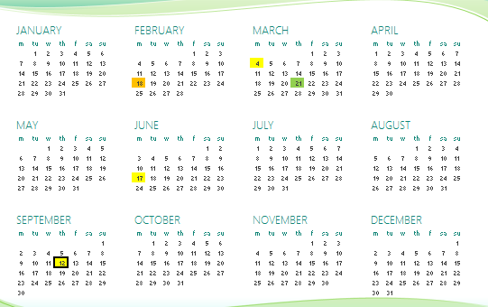
6. Meeting schedule
RCC
IG
SG
Next IG meeting: XX November (tentative date, tbd)

Slide 18
Thank you for attending

